Slide 1
Surfactant Stability Evaluation Analysis
Case Study

Slide 2
The problem
About the Company
The problem
This biotechnology company is working on a medical device that will use a microfluidics to help doctors diagnose bacterial pneumonia patients.
The old raw material that was used to make a vital component of our device has been discontinued by the manufacturer.
Our company needs us to evaluate a sample of a new raw material before deciding to order it in bulk.

Slide 3
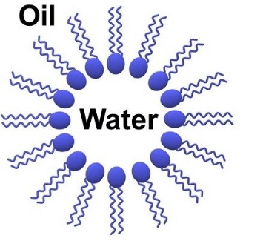
What is an emulsion?
Micelle:
Oxford dictionary: “A fine dispersion of minute droplets of one liquid in another in which it is not soluble or miscible.”
In our context:
The emulsion solution is composite of water-based micelles suspended in an oil solution.
Each micelle contains nutrient rich broth used for growing and analyzing the metabolism of a single bacterial cell with the hopes of diagnosing infections in future patients.
Image source: Schematic structure of a reverse and normal micelle. | Download Scientific Diagram (researchgate.net)

Slide 4
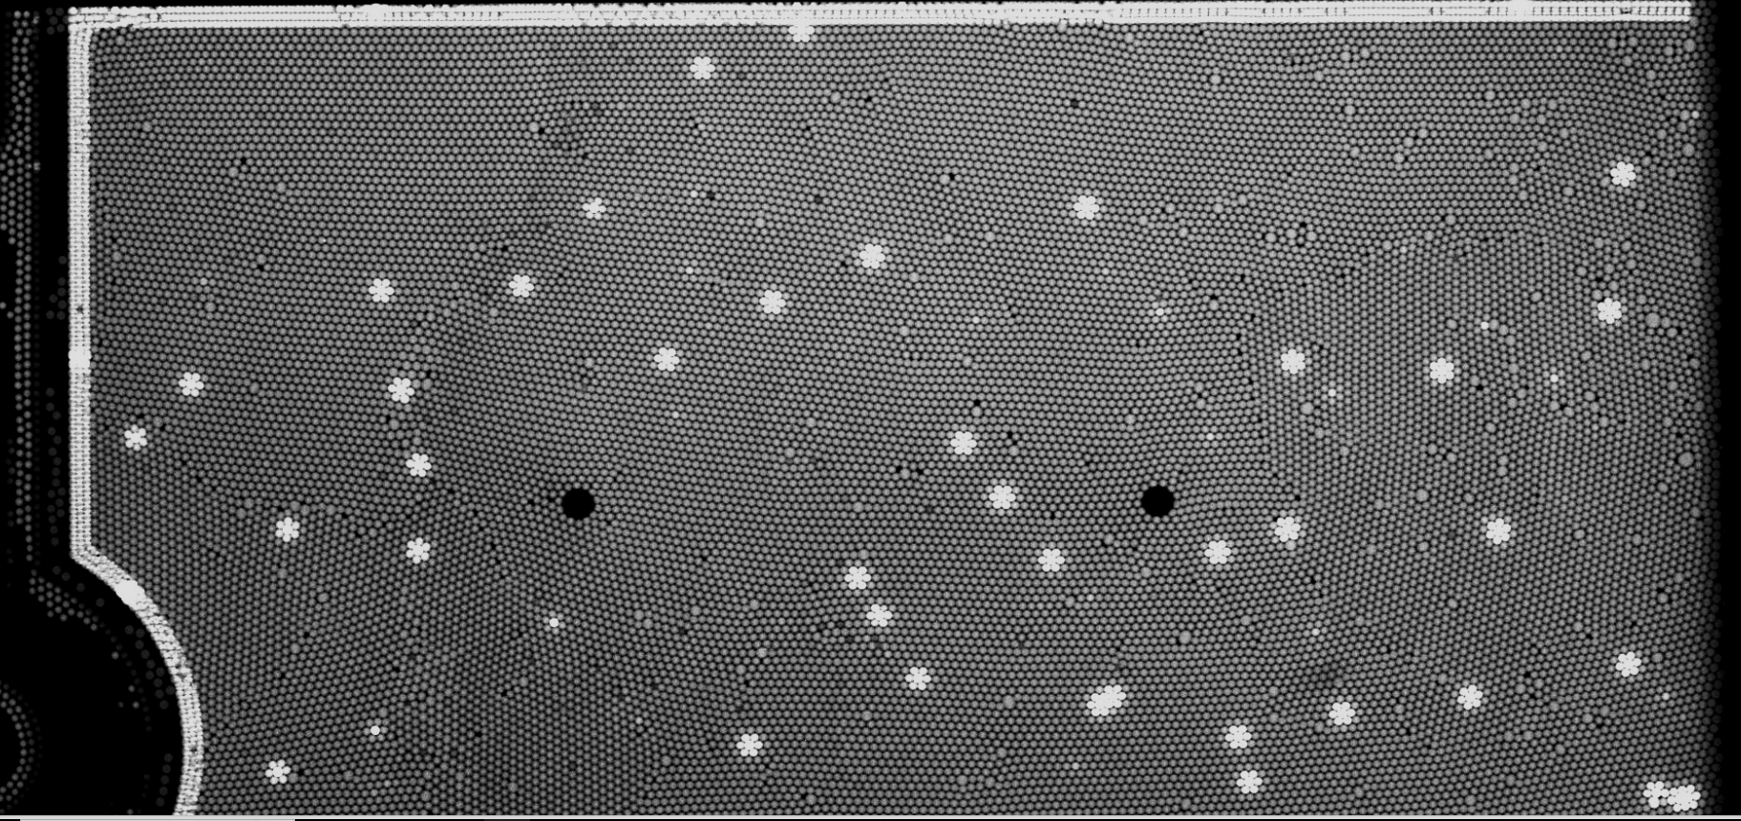
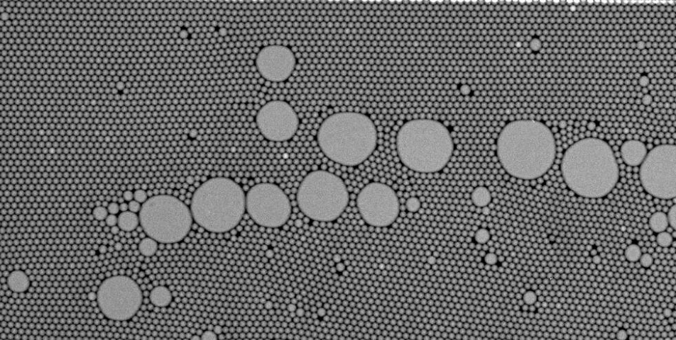
What is a Surfactant?
Strong Emulsion:
The emulsion is the interface from which this metabolic data is collected.
A strong emulsion is necessary to gather accurate data.
A weak emulsion skews this data.
The key component of the emulsion oil phase that most influences micelle strength is called a surfactant.
We synthesize our surfactant in house from various raw materials
Weak Emulsion:

Slide 5
Experimental Design
Purpose: The old raw material that was used to make the prior surfactants has been discontinued by the manufacturer. Our company has asked us to evaluate a new raw material to potentially replace the old one.
Context:
Our previous best performing surfactant came from the reaction “NK-R38.” This is the standard we are trying to meet.
“NK-R84” is a surfactant that performed worse than NK-R38, but still satisfactory enough for our product to collect good data (R&D grade).
These two reactions will be used as controls.

Slide 6
Experimental Design
Test Subjects:
NK-R102
NK-R104
These are replicates (same raw material, two different bottles of the same lot)
Approach: The stability of each test surfactant will be assessed by using patient lung samples to stress the emulsion to a breaking point. Each test surfactant will be evaluated against controls NK-R38 and NK-R84. Additionally, NK-R102 and NK-R104 will be evaluated against each other to asses bottle variability. For each surfactant will use a sample size of n=10 for EACH lung sample. So in total each surfactant will be tested 200 times (800 records all together).
Questions: Do we notice any bottle to bottle variability in this new raw material? Should the company purchase 100 kilograms ($30,000) of this new raw material?

Slide 7
Visualization & Analysis
Metrics:
Doublets
FFF/FFI Ratio
Total Droplets

Slide 8
Metrics: Total Droplets

Slide 9
What are Total Droplet counts?
We have been able to determine the total number of single, normally-sized, droplets that should be present in a properly filled chip window.
That number is 25,000 droplets
If the total number of droplets is less than 25,000, then it is likely that droplets have coalesced into bigger droplets.
This metric is highly influenced by the quality of the surfactant.

Slide 10
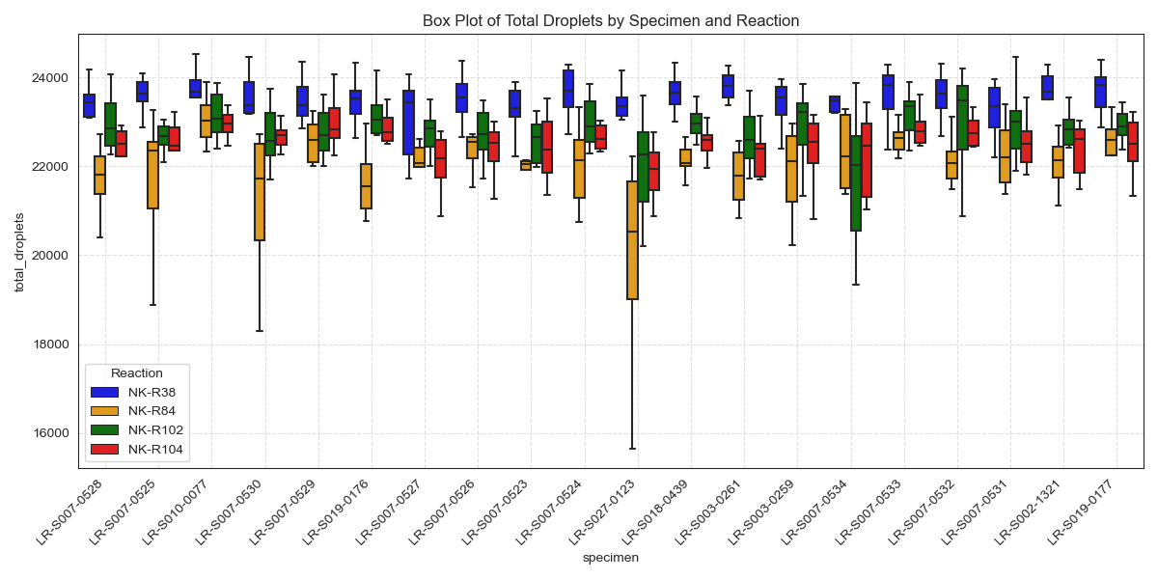

Slide 11
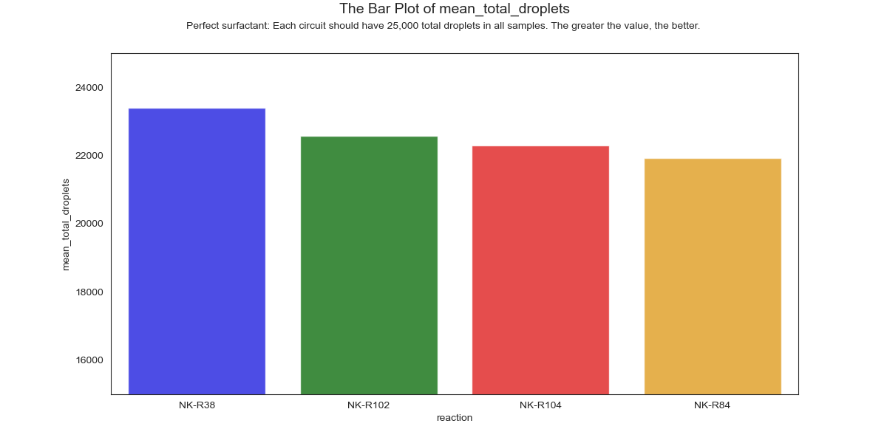

Slide 12
Doublets

Slide 13
What is a Doublet?
A doublet consists of two properly-sized single droplets that have coalesced into one droplet that contains twice the volume that it should.
The formation of doublets is highly indicative of surfactant quality
The fewer doublets present, the better the surfactant is.

Slide 14
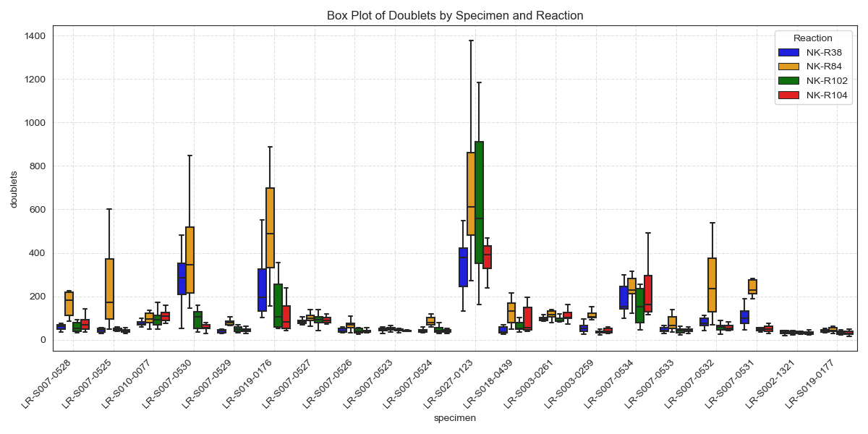

Slide 15
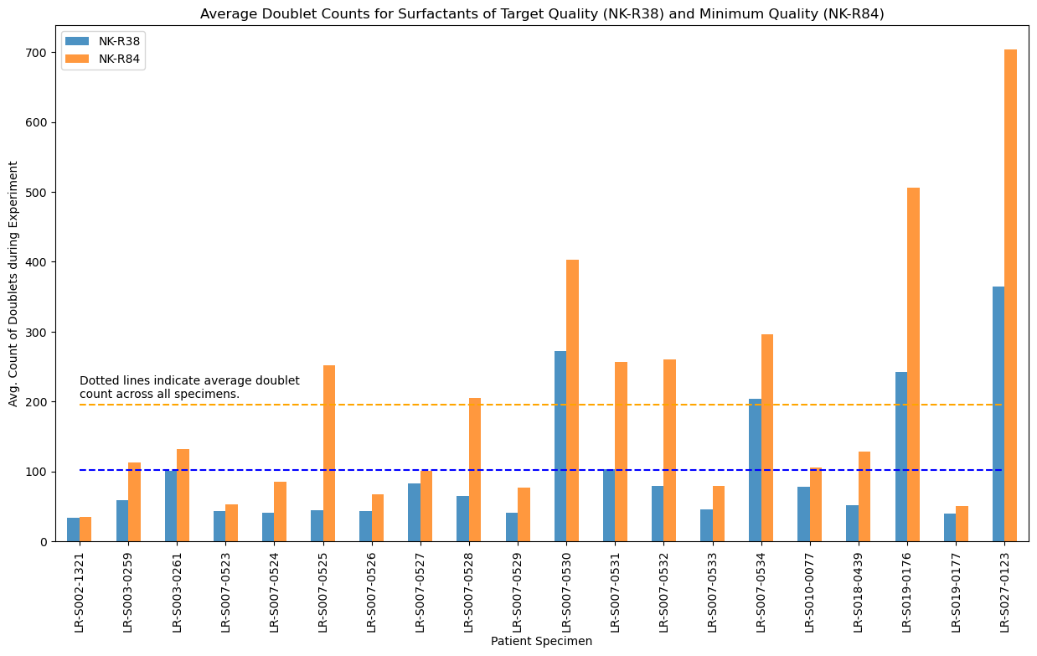
Between the dotted lines is the target range for the test surfactants.
Notes:
Why we want to avoid doublets
This is the target range

Slide 16
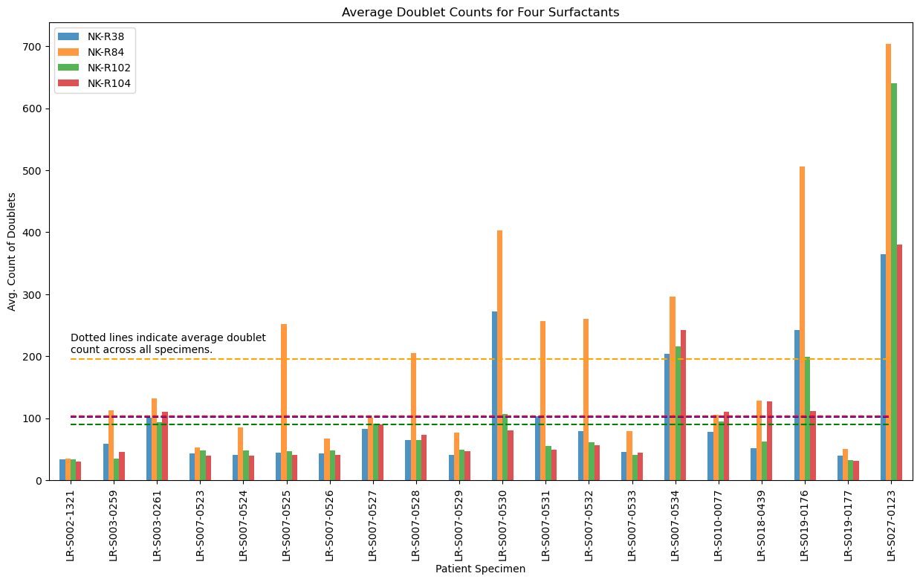
Both surfactants are in the target range; one even exceeds the ideal.
Notes:
Also showing the surfactants in question here
NK-R104 is really close to NK-R38
NK-R102 is better!

Slide 17
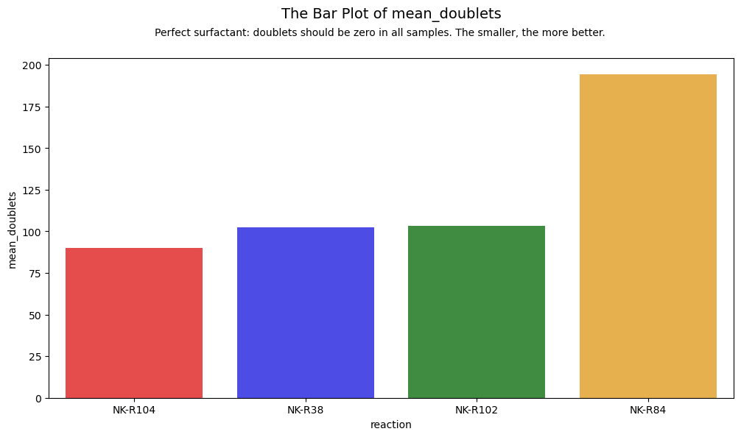

Slide 18
What is Fill Factor?
Fill factor is a count of the total droplets present at the different stages of the incubation period (~6 hours)
FFI (fill factor initial): The total number of droplets present when the specimen is first loaded into the chip
FFF (fill factor final): The number of droplets present when the incubation period is over and we finish collecting bacterial data.
If fewer droplets are observed at the end of the study than were observed at the beginning, it is highly likely that those droplets were lost to coalescence.

Slide 19
Fill Factor Score:
| 1 - (initial f.f. / final f.f.)|
Notes:
What is ‘fill factor’?
Explain the equation

Slide 20
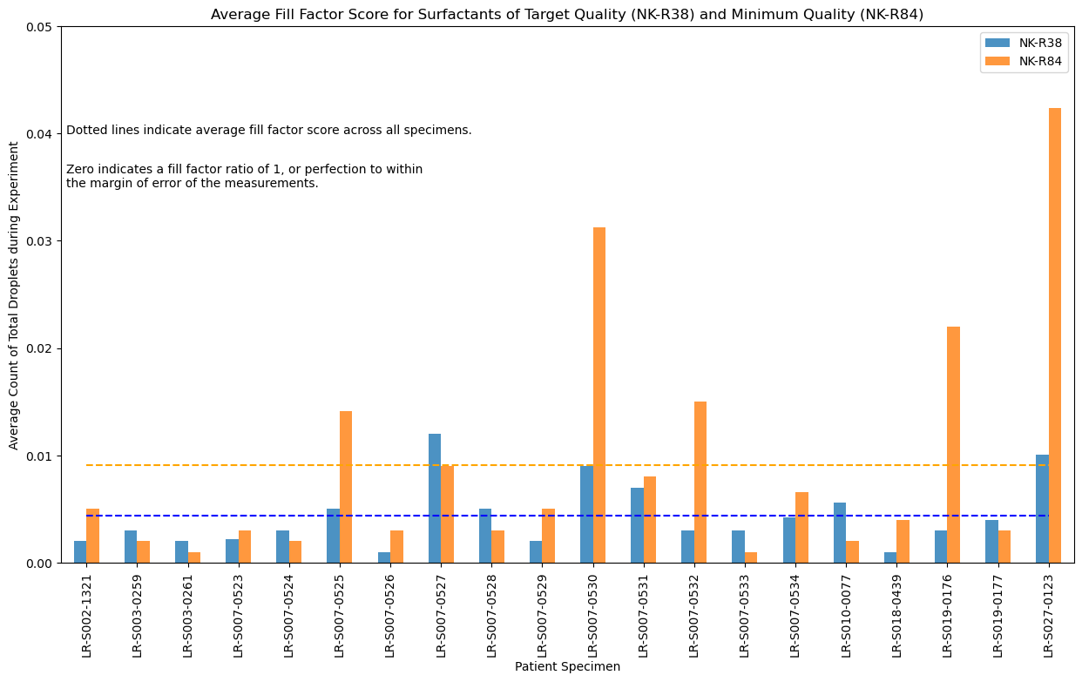
Between the dotted lines is the target range for the test surfactants.
Notes:
Establishes target range of fill factor score
Zero is perfect

Slide 21
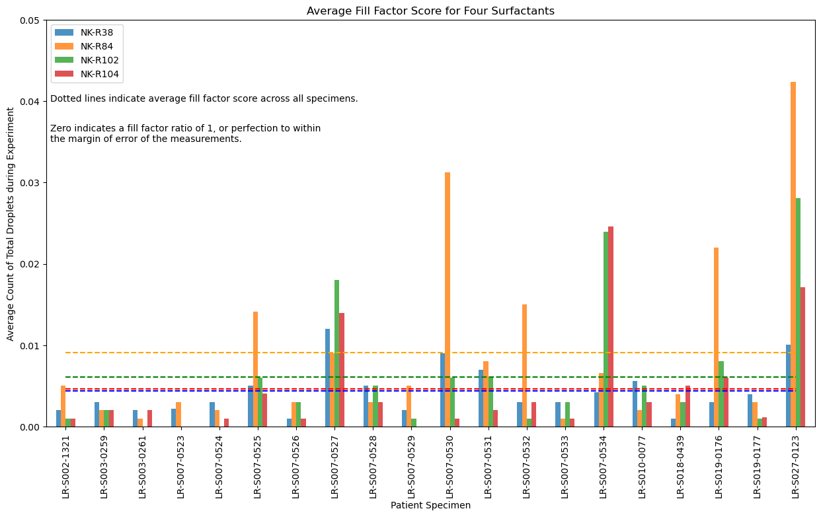
Both target surfactants are in the acceptable range.
Notes:
Both are in acceptable range
NK-R104 “wins”

Slide 22
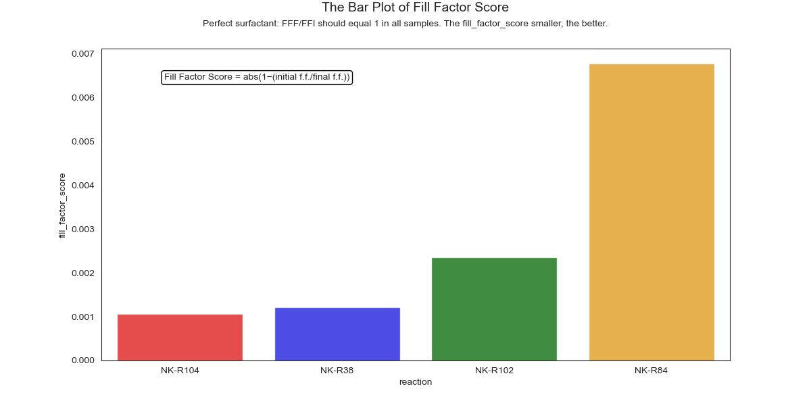

Slide 23
Statistics

Slide 24
Statistical Methodology
To determine the effectiveness of different surfactants in maintaining micelle formation in the emulsion solution for diagnosing bacterial pneumonia.
Hypotheses
Null Hypothesis (H0): There is no significant difference in the effectiveness of different surfactants.
Alternative Hypothesis (H1): There is a significant difference in the effectiveness of different surfactants.
Experimental Design
Surfactants
Surfactant A (e.g., NK-R102)
Surfactant B (e.g., NK-R104)
Surfactant C(compare) (e.g., NK-R84)
Metrics
Total Droplets
Doublets
Fill Factor Score

Slide 25
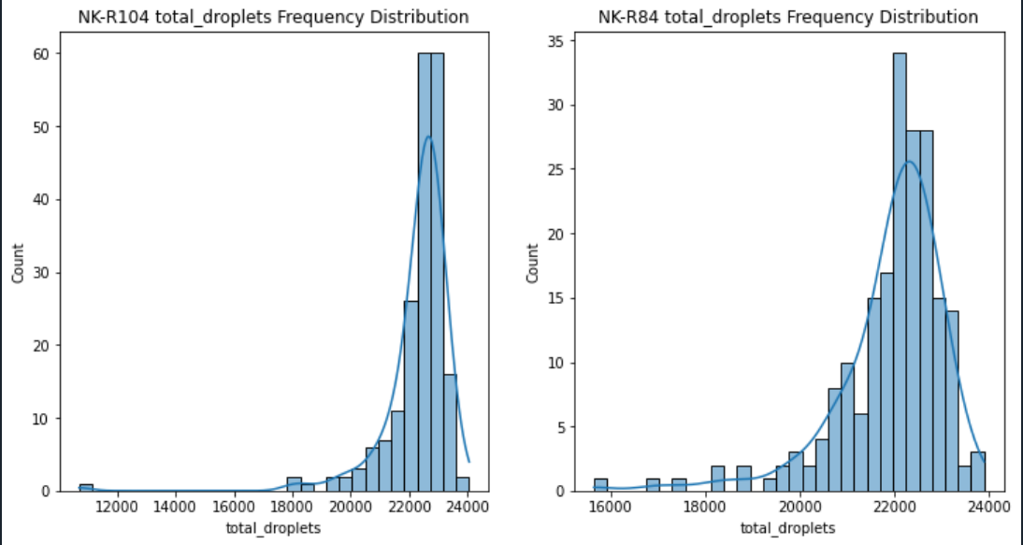
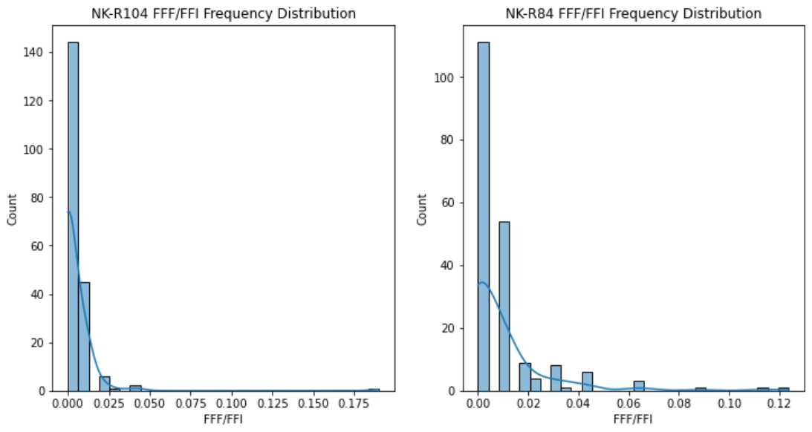
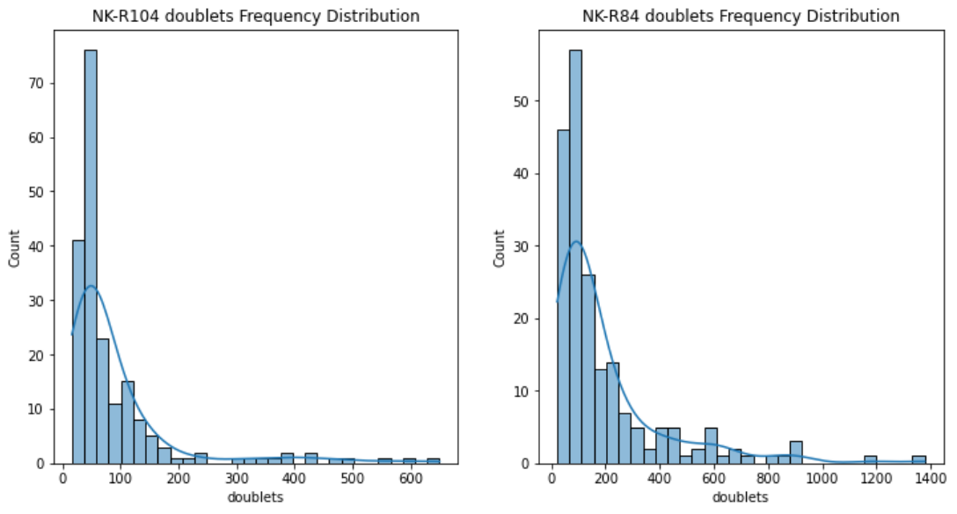
Frequency Distributions
All metrics show extreme or near extreme skewness
Product of experimental data
Needs transformation
May violate certain assumptions

Slide 26
Methodology, 2
Data Preparation
Calculated FFF/FFI
FFF/FFI was calculated as |1 - (initial fill factor / final fill factor)|.
Data Conversion
Converted data to numeric and handled non-numeric values.
Handling Missing Values
Dropped missing values to ensure clean and reliable analysis.
Exploratory Data Analysis (EDA)
Summary Statistics
Computed summary statistics for each metric to understand central tendency and variability.
Data Transformation
Applied log transformation to handle skewness and make the data more normally distributed for hypothesis testing.

Slide 27
Methodology, 3
Hypothesis Testing
T-tests
Conducted t-tests after log transformation to compare means
Mann-Whitney U Tests
Conducted Mann-Whitney U tests on original data to compare distributions
Justified because the data is not normally distributed
Effect Size Calculation
Cohen's d
Calculated Cohen's d to assess the practical significance of differences

Slide 28
Doublets
NK-R102 vs NK-R84: Highly significant difference (p < 0.001) with a medium effect size (-0.464), indicating that NK-R84 has a substantially higher mean value of doublets compared to NK-R102. A higher number of doublets can be indicative of undesirable aggregation, suggesting that NK-R102 is a preferable choice.
NK-R104 vs NK-R84: Highly significant difference (p < 0.001) with a medium effect size (-0.615), again showing that NK-R84 has a much higher mean value of doublets compared to NK-R104. This further supports the superiority of NK-R104 in minimizing aggregation.

Slide 29
FFF/FFI
NK-R102 vs NK-R84: Significant difference (p < 0.05) with a small effect size (-0.204), showing that NK-R102 has a lower mean FFF/FFI value compared to NK-R84. Lower FFF/FFI values suggest better consistency and stability, favoring NK-R102.
NK-R104 vs NK-R84: Significant difference (p < 0.01) with a small effect size (-0.303), indicating NK-R104 also has a lower mean FFF/FFI value than NK-R84. This points to better performance and stability of NK-R104.

Slide 30
Total Droplets
NK-R102 vs NK-R84: Significant difference (p < 0.01) with a medium effect size (0.476), suggesting that NK-R102 produces more stable and consistent results in terms of total droplets compared to NK-R84.
NK-R104 vs NK-R84: Significant difference (p < 0.01) with a small effect size (0.313), indicating NK-R104 also performs better in producing consistent total droplet counts compared to NK-R84.

Slide 31
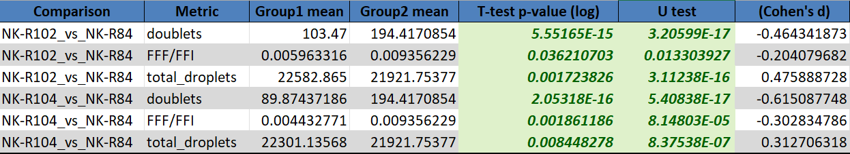
Conclusion & Recommendation
Given the significant improvements in doublets, FFF/FFI, and total droplets metrics, both NK-R102 and NK-R104 demonstrate superior performance over NK-R84.
Therefore, it is recommended to prioritize the use of NK-R102 and NK-R104 over NK-R84 in applications where minimizing aggregation and improving stability and consistency are critical.
Note: Green means significant at P-value of .05
Notes:
Green means statistically significant

Slide 32
Metric Limitations
Total Droplets
A common problem that we run into is that certain ingredients or conditions might shrink the droplet size and skew the data. This is why we include FFF/FFI ratio as a metric. If droplets are a different size, the FFF/FFI ratio will not be affected.
We do have software to measure droplet size but that data is confidential.

Slide 33
Metric Limitations
Doublets
This metric only counts doublets and nothing larger (can’t always visualize the whole picture of what might be happening). This is why we also look at total droplets and fill factor score

Slide 34
Sample Limitations
Due to the uniqueness of each patient lung sample, any data from this study can NOT be compared directly to any past or future studies.

Slide 35
Future Research
When the new product arrives it will likely come in a large storage drum. This might be problematic because we know that our raw material is made up of a gradient of different polymer chain lengths.
It is possible that if stored upright for a long period of time, the different lengths might separate out based on density and the polymer distribution of each aliquot taken for reactions might be different.
We have observed in the past how different sizes of polymer chain length have influenced emulsion stability.
When the drum arrives, we will use the same process/metrics outlined in this experiment to evaluate the polymer chain distribution at different depths of the drum.

Slide 36
Thank You

